Slide 1

Online Food Delivery
Submitted by: Chetana B. Bachhav
Program : HDFC API Developer Program

Slide 2
Table of Content
Introduction
Project Overview
UML Diagrams :
1. Use Case Diagram
2. Class Diagram (Entity and Service)
3. Sequence Diagram
Results

Slide 3
Technologies Used
JAVA
Spring Boot
MySQL
Hibernate
Swagger
Spring Data JPA
Spring Framework

Slide 4
Modules
Signup,Login/Logout Module
Restaurant Module
Customer Module
Order Module
Menu Items Module
Payment Module
Cart Module

Slide 5
Features
Admin Features :
Administrator Role of the Entire Application.
Admin can add/update/delete/view Restaurants or Customers from main Database.
Admin can access the details of different Customers,Restaurants and Orders.
Customer Features :
Registering themselves with application.
Viewing list of available items and ordering it.
Customer can view cart details, place an Order,update and access other features.

Slide 6
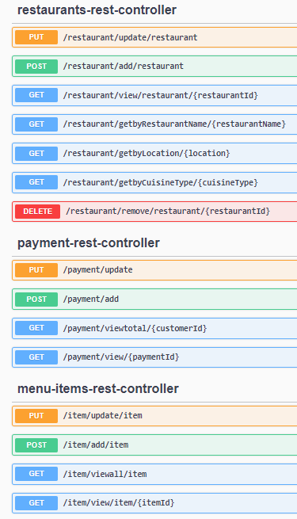
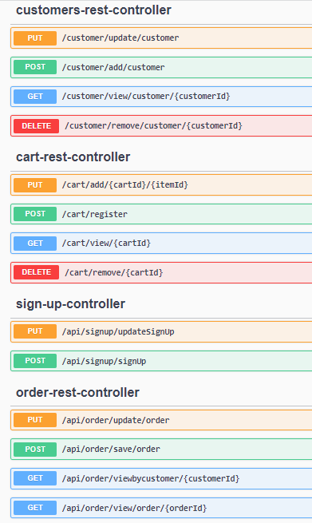
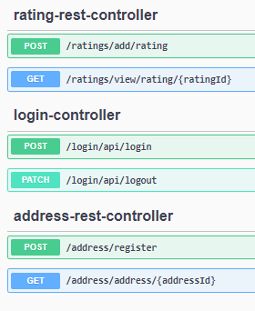
User Interface Design

Slide 7
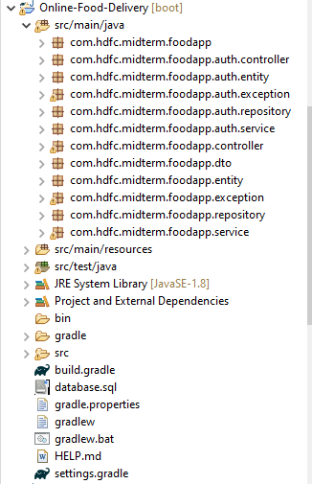
Project Structure

Slide 8
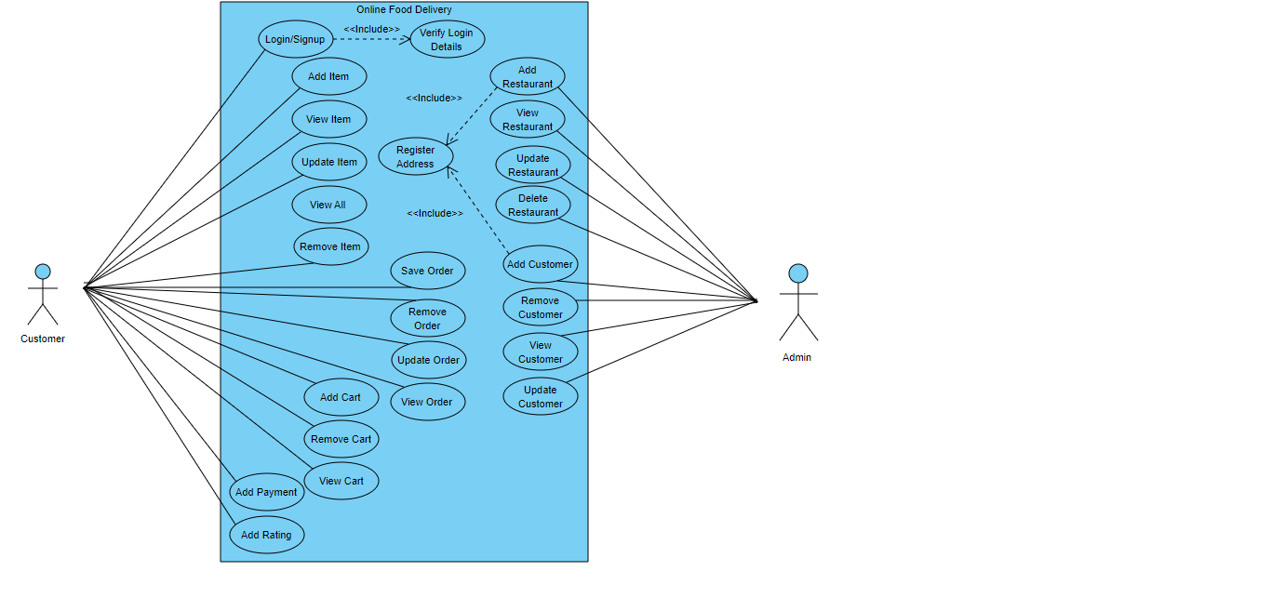
Use case Diagram

Slide 9
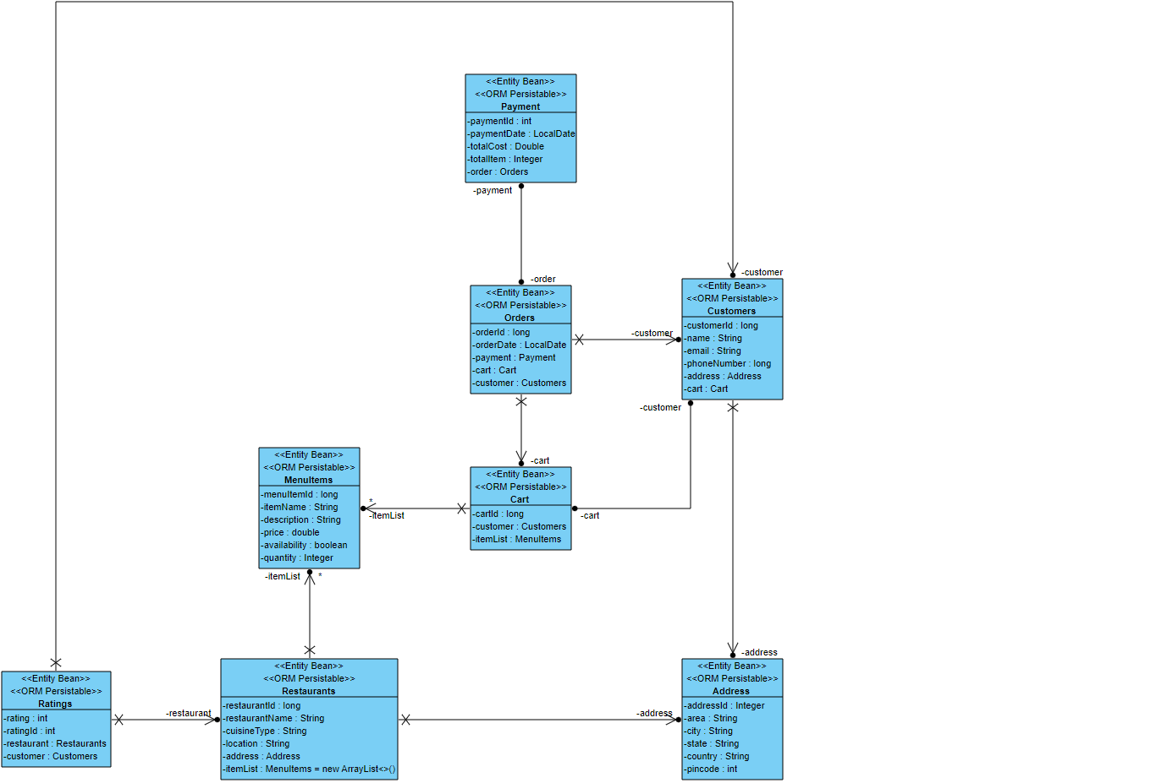
Class Diagram (Entity)

Slide 10
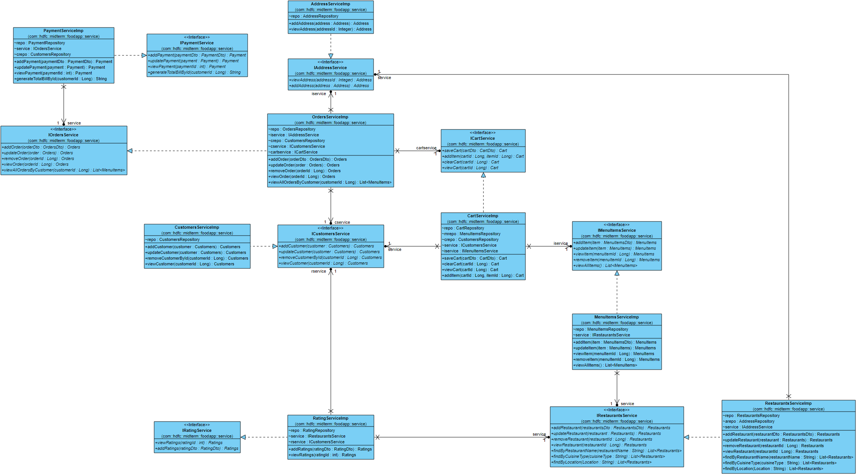
Class Diagram (Service)

Slide 11
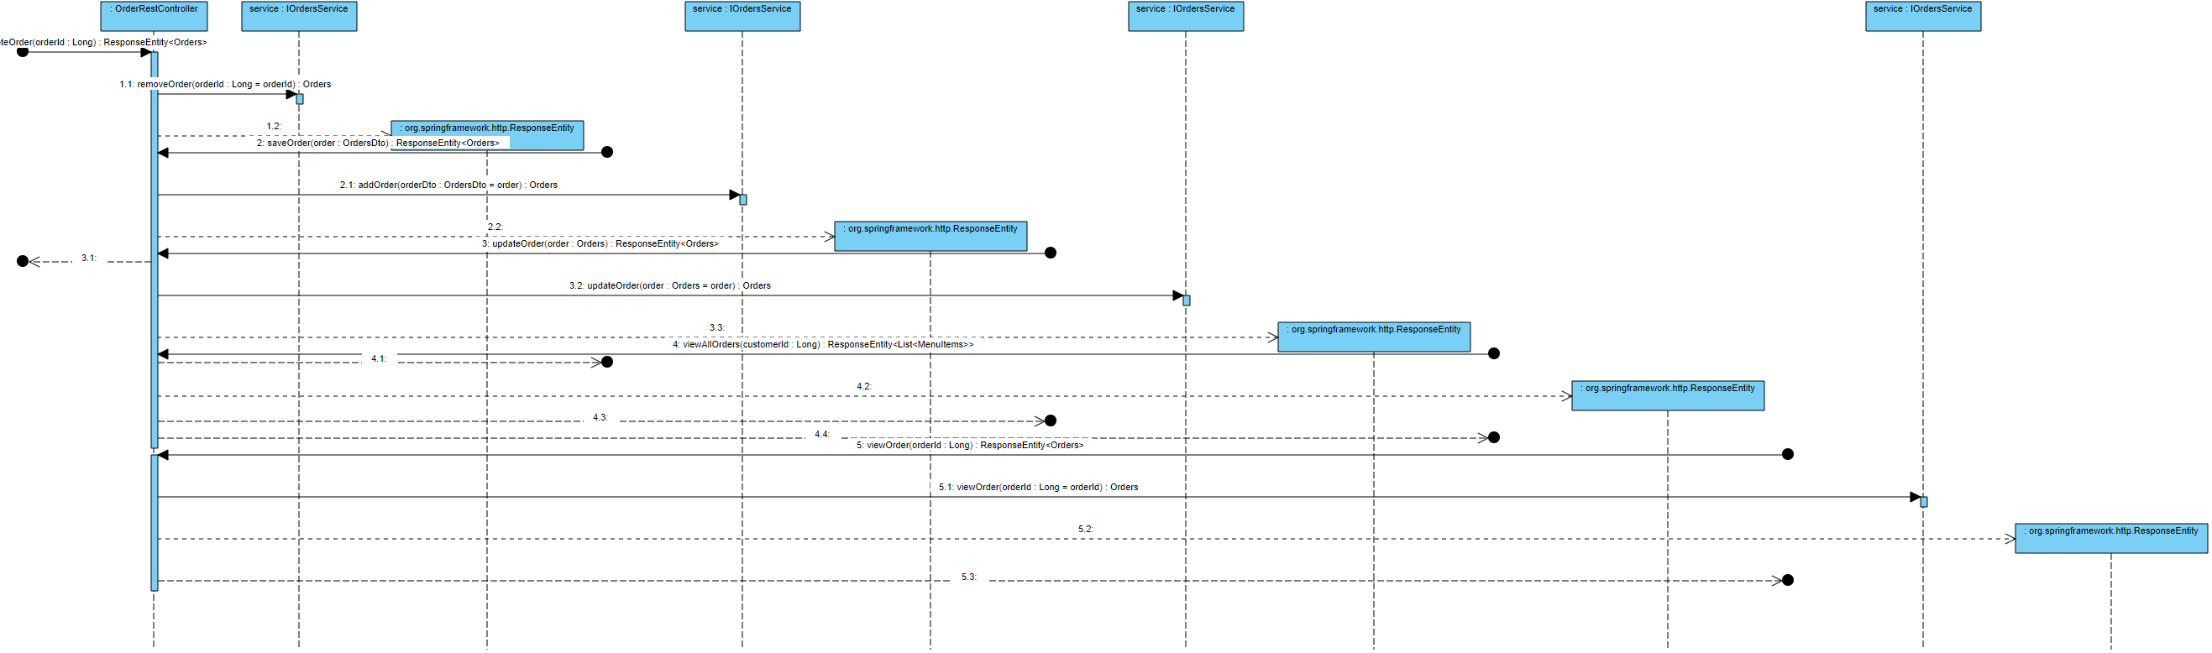
Sequence Diagram-Order Rest Controller

Slide 12
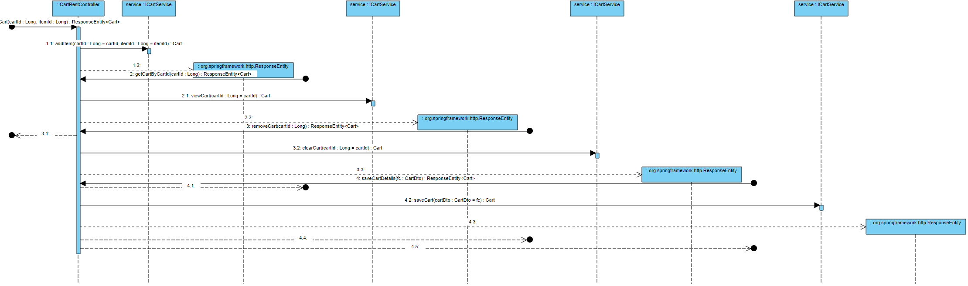
Sequence Diagram-Cart Rest Controller

Slide 13
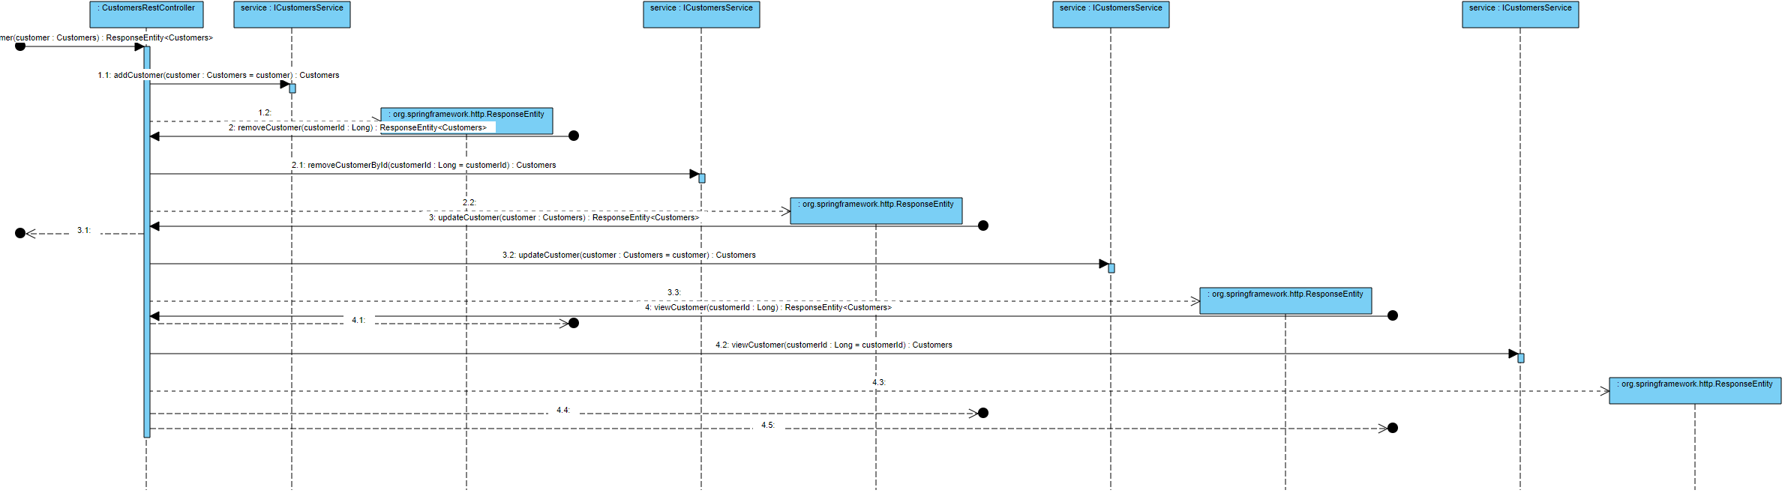
Sequence Diagram-Customer Rest Controller

Slide 14
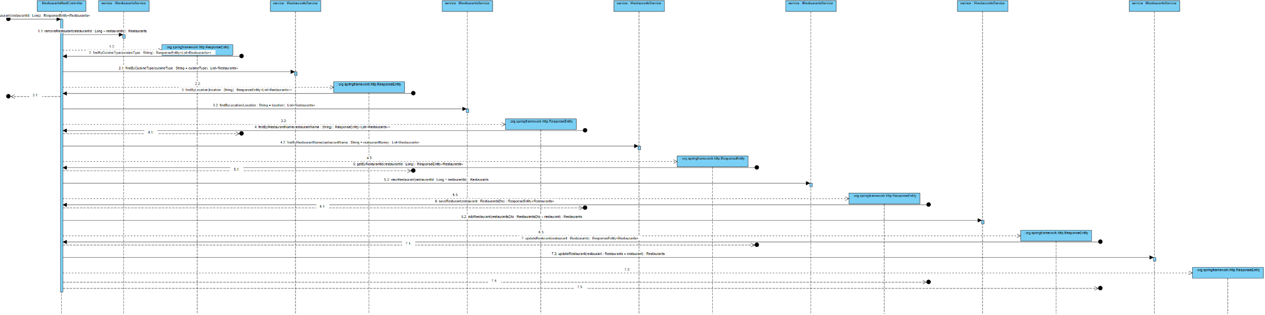
Sequence Diagram-Restaurant Rest Controller

Slide 15
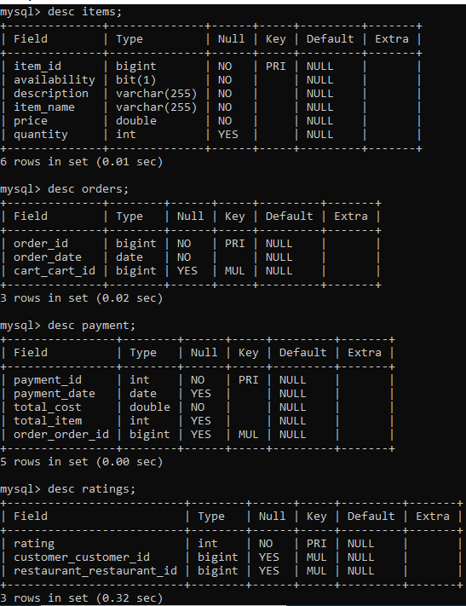
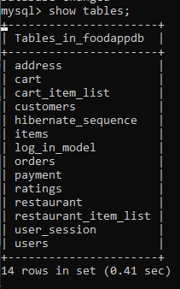
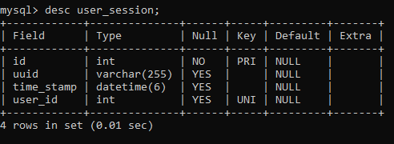
Database Structure

Slide 16
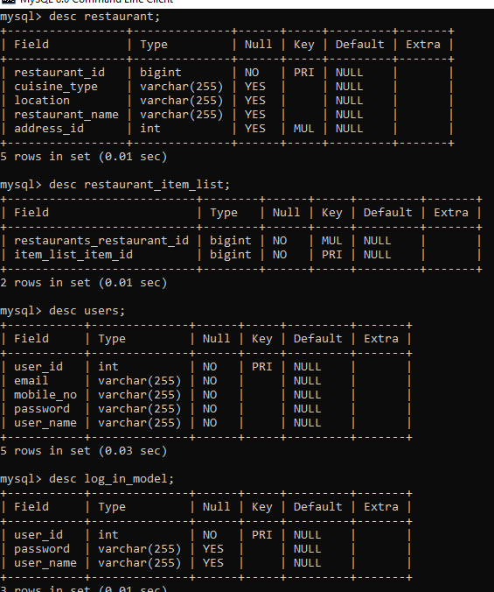
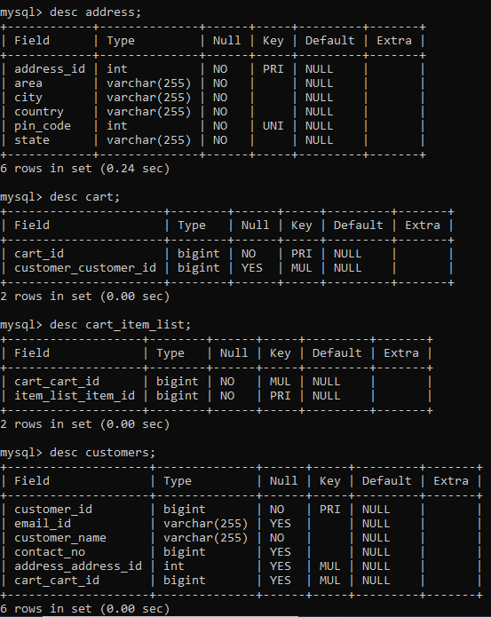

Slide 17
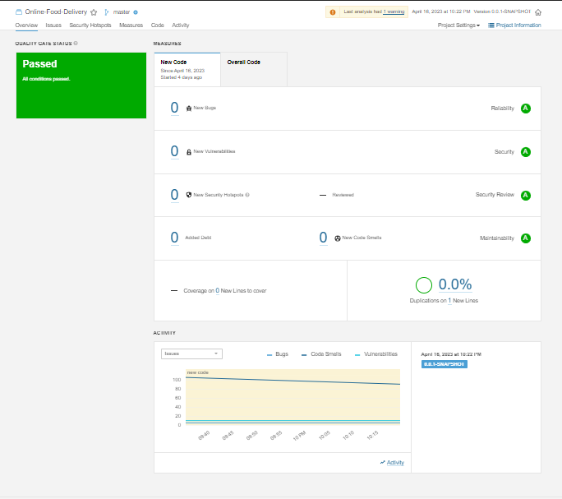
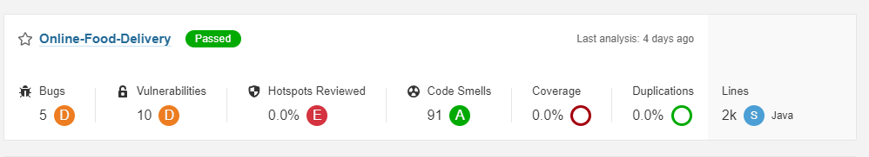
Testing-Sonarqube

Slide 18
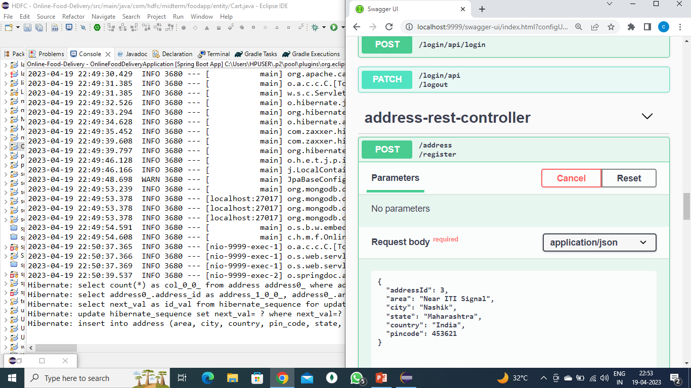
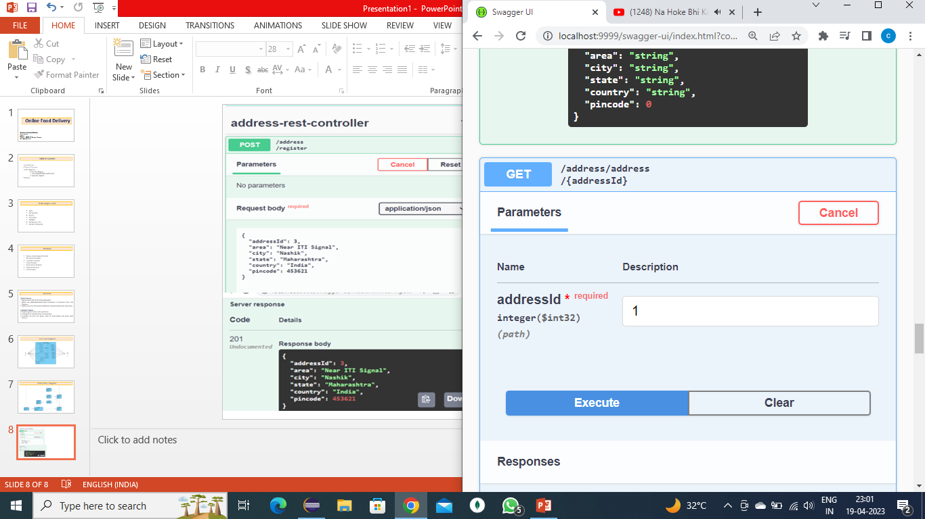
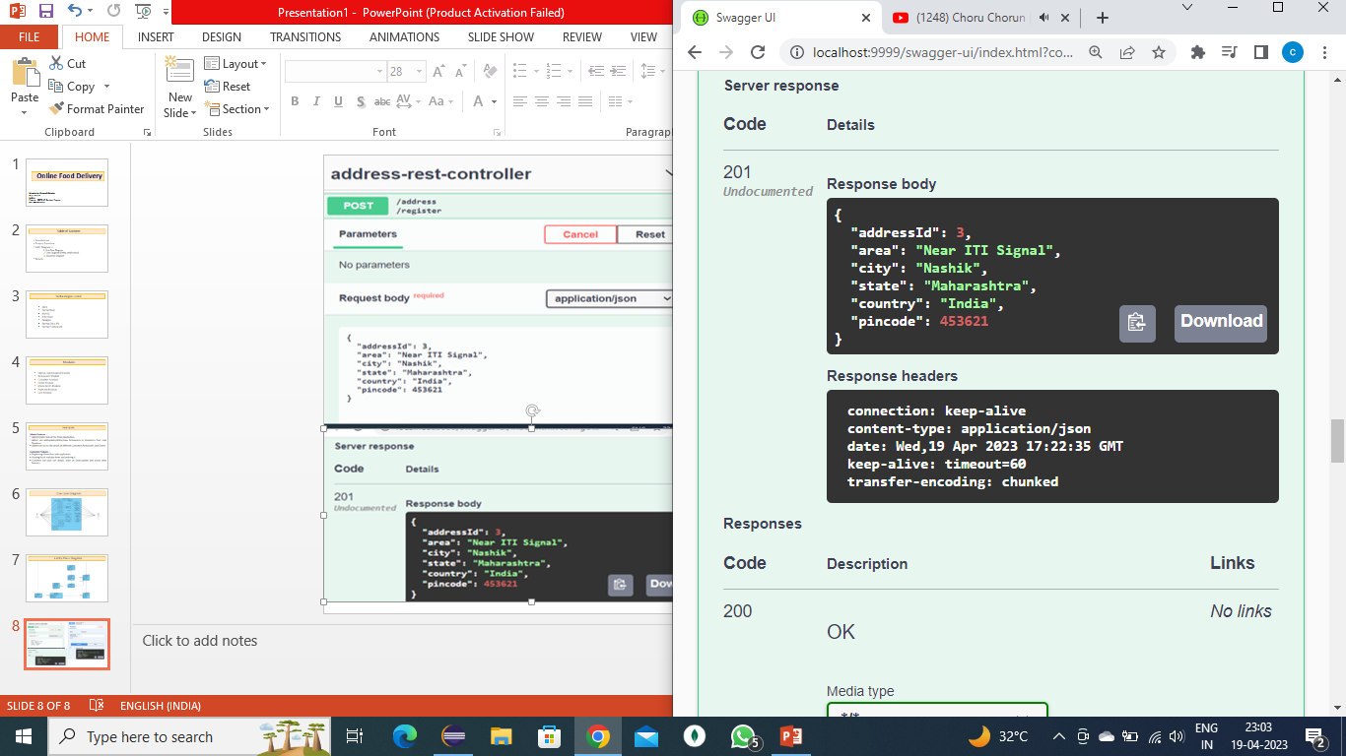
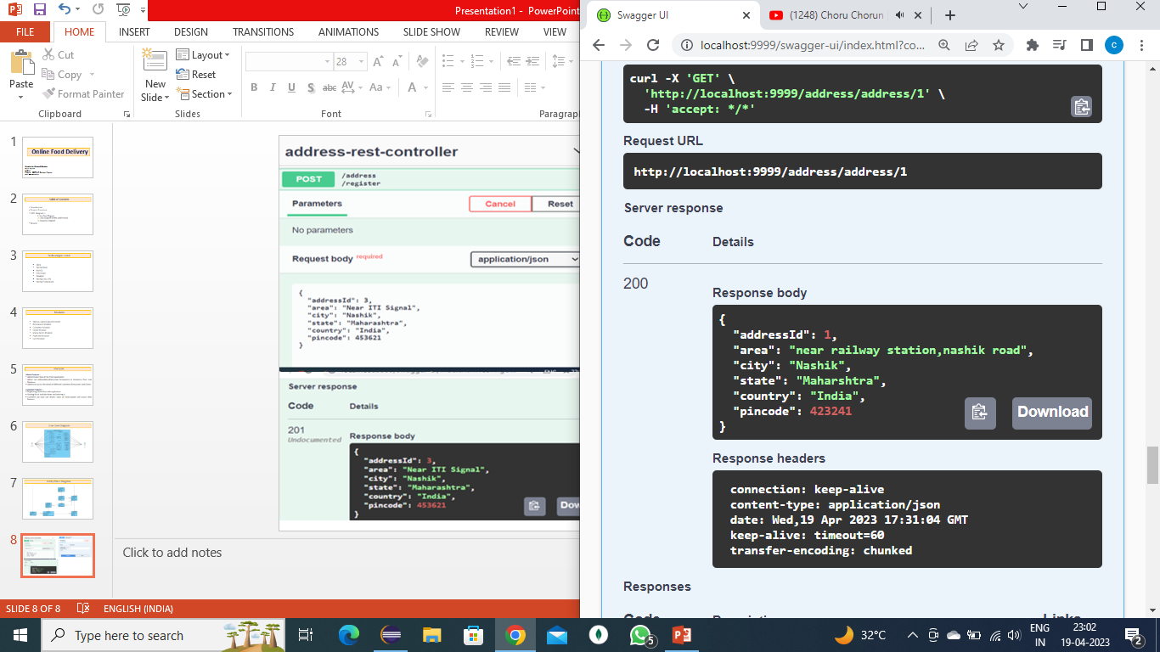
Address Rest Controller

Slide 19
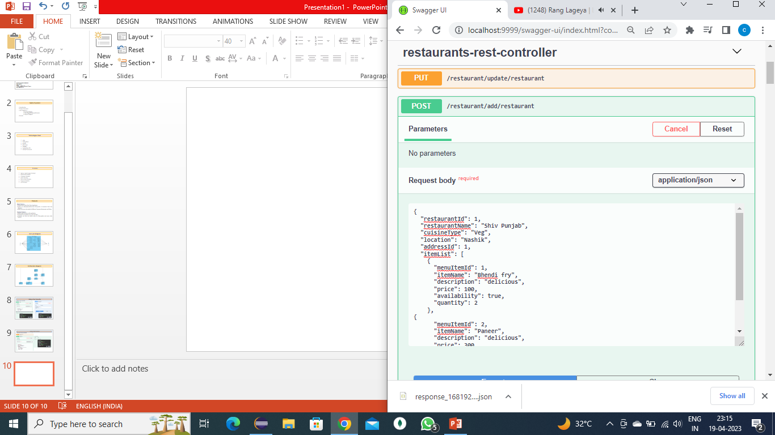
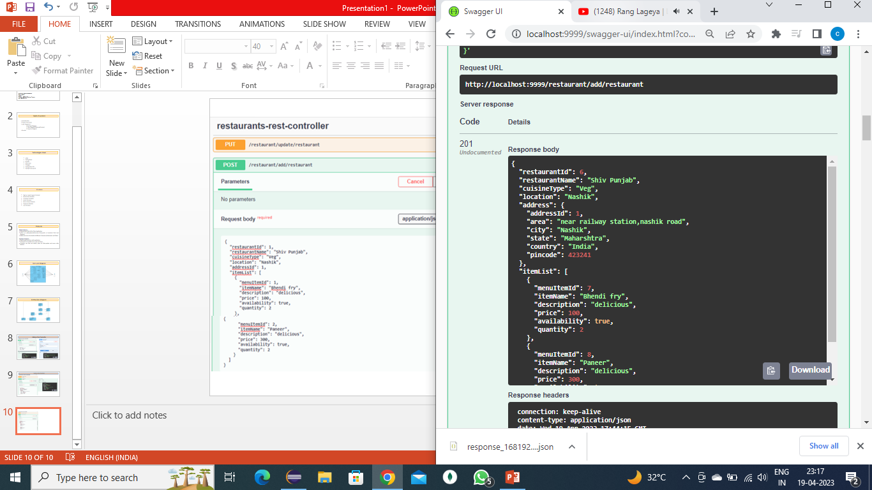
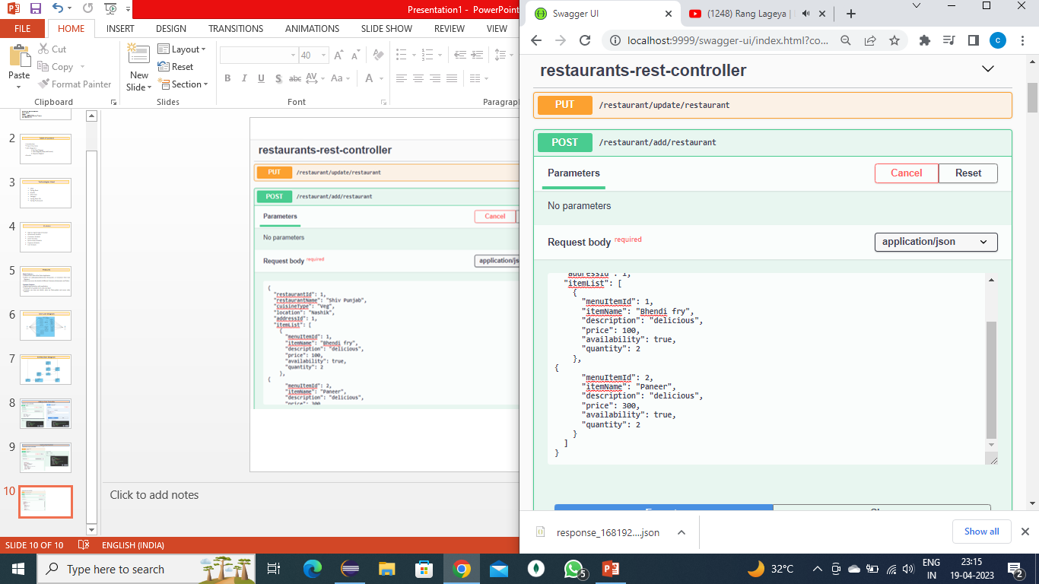

Restaurant Rest Controller

Slide 20
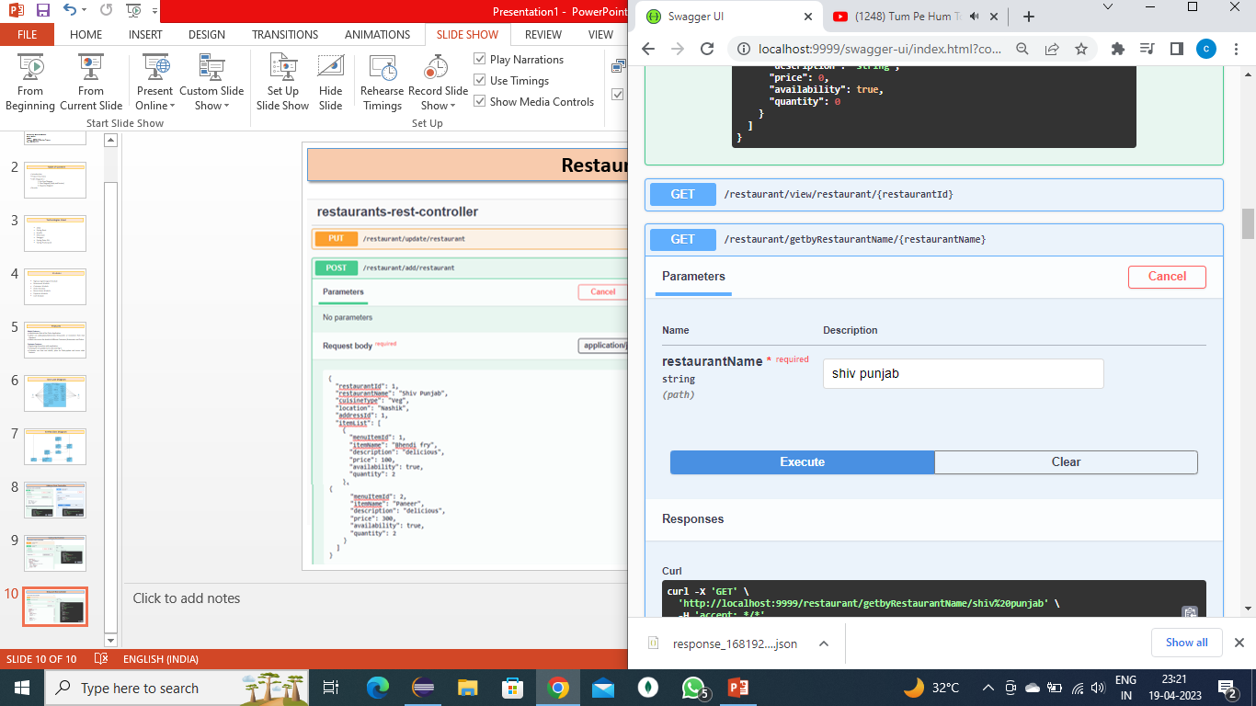
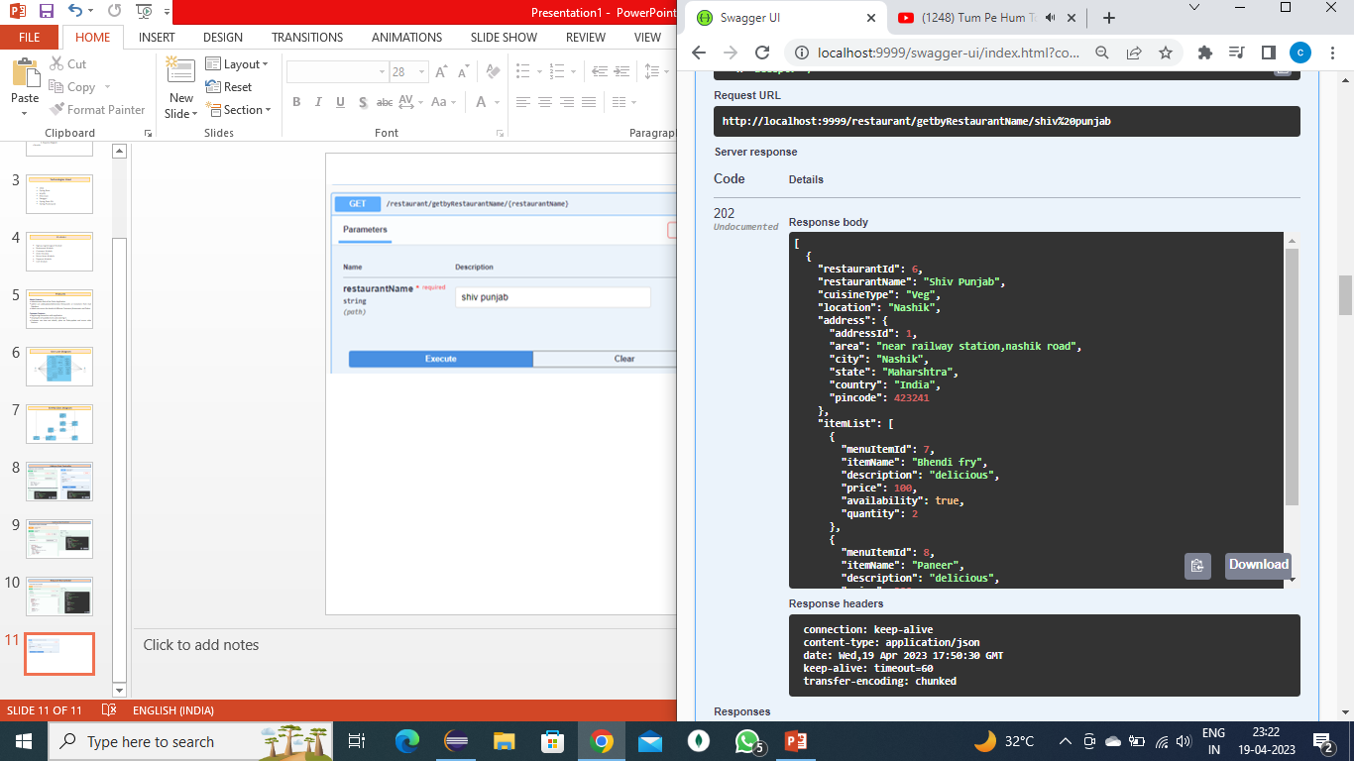

Restaurant Rest Controller

Slide 21
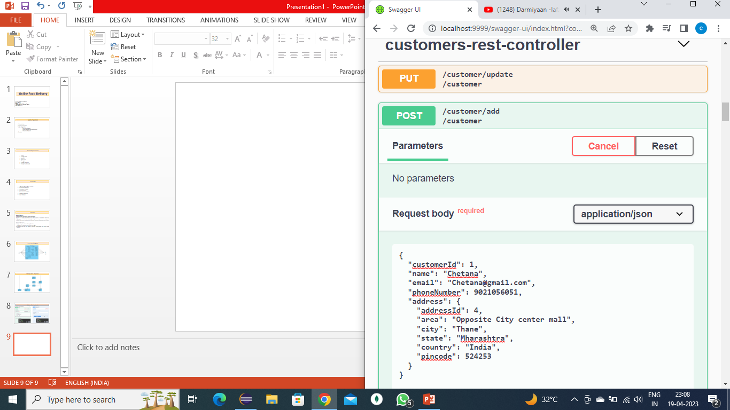
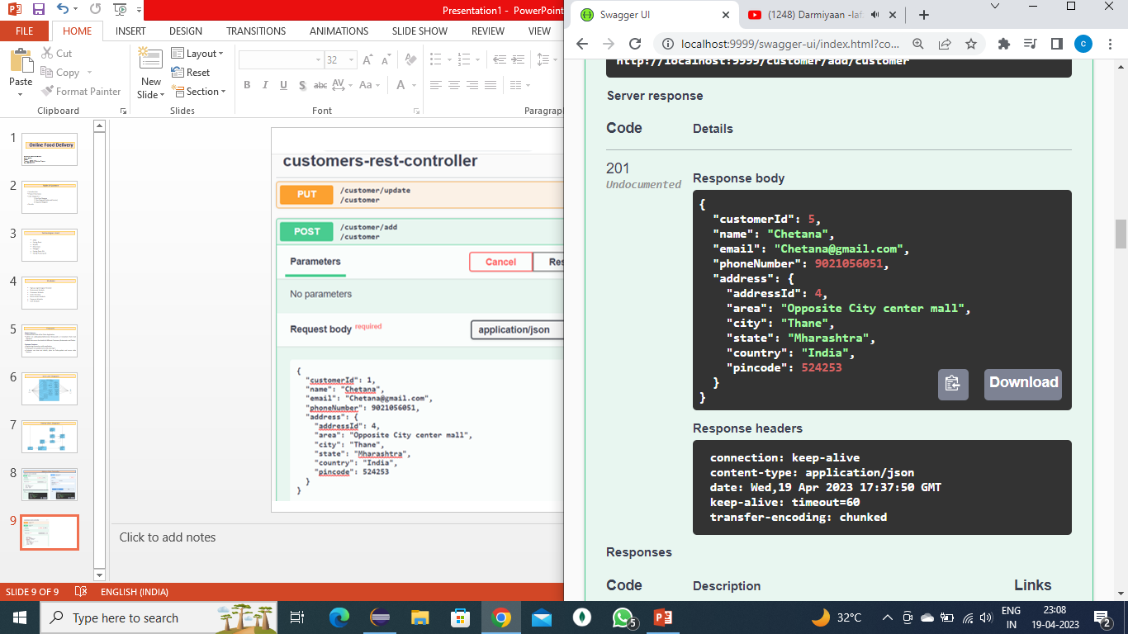
Customer Rest Controller

Slide 22
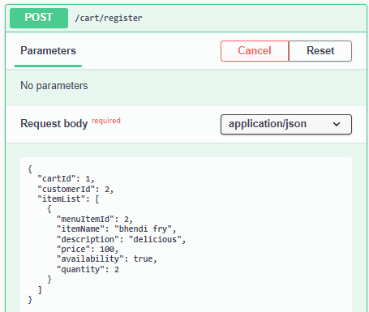
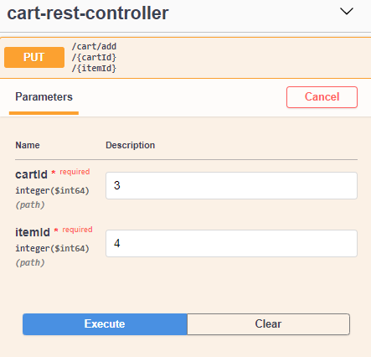
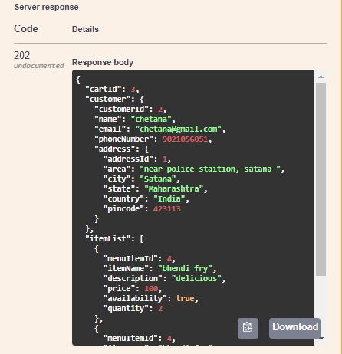
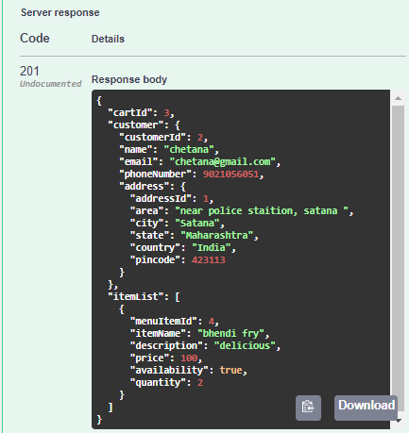
Cart Rest Controller

Slide 23
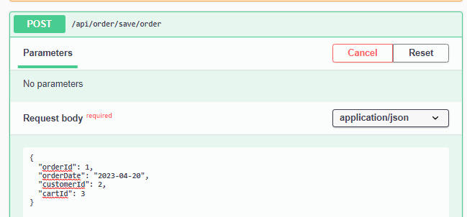
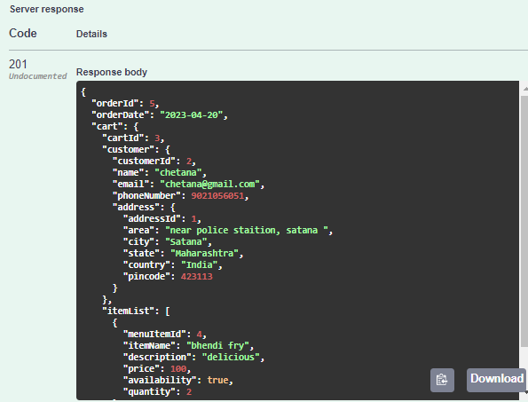
Order Rest Controller

Slide 24
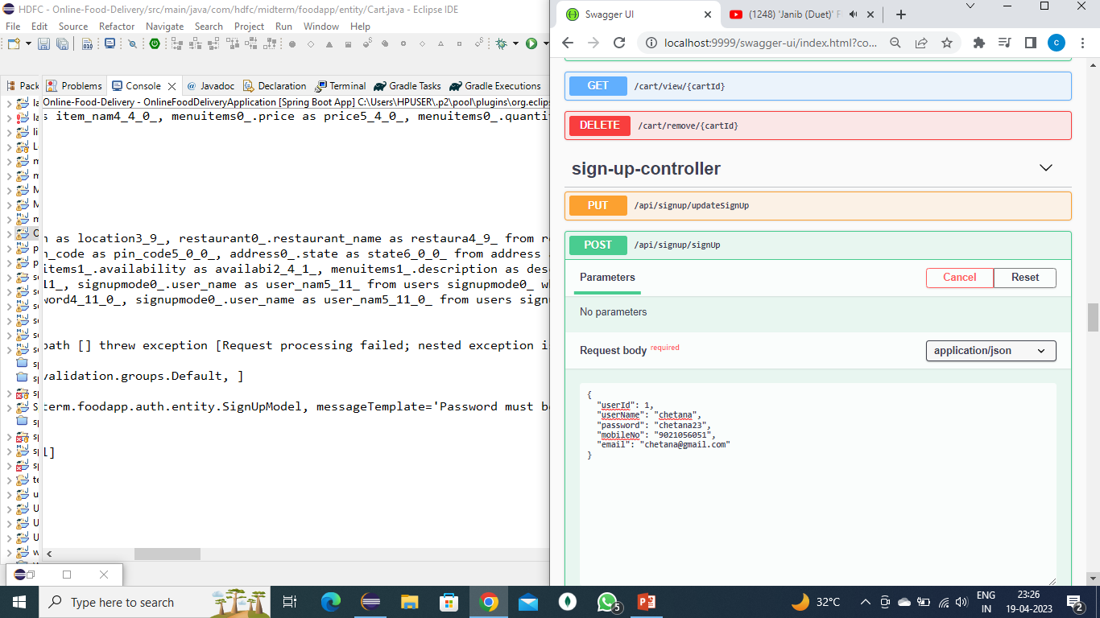
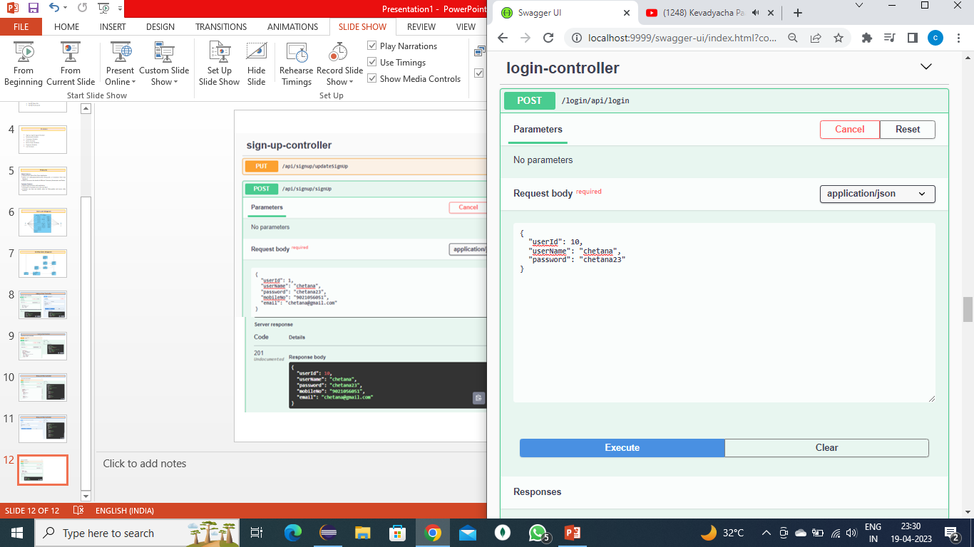
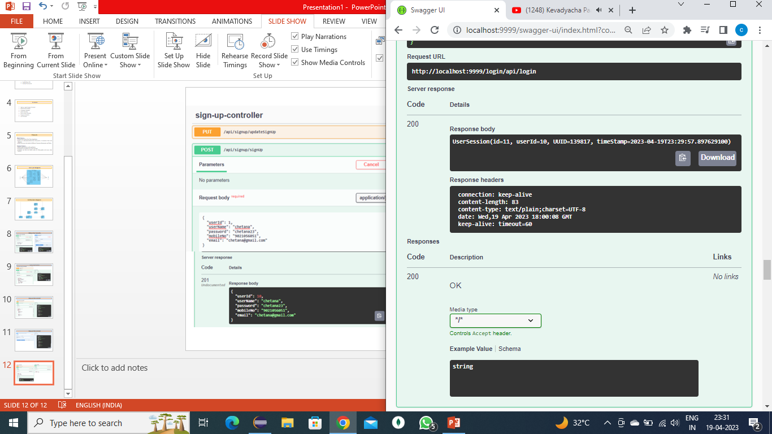
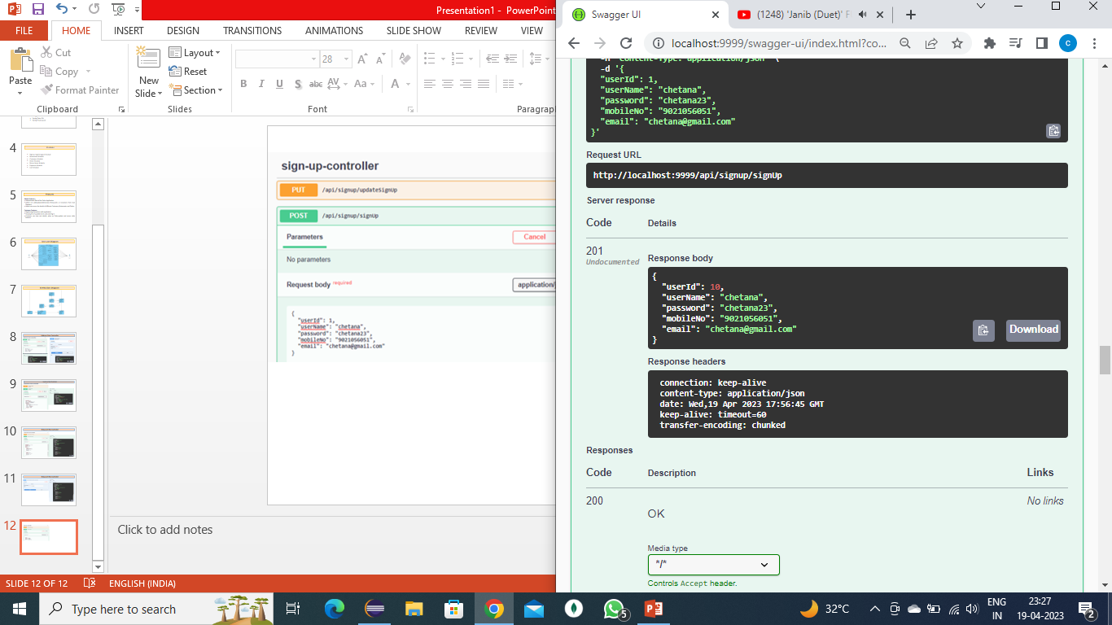
Sign-up-Controller
Login-Controller

Slide 25
Thank You

